Slide 1
Deliverable Check`
Landen Barber

Slide 2
No 3d models or PCB printed Yet
Even though I said I would print these weeks ago I keep putting it off.
Did one last rework of the pin assignments to give room for one more module to expand the storage using SPI microSD card.
Was not confident in the amount of storage the board had so I decided to add another part to give me more wiggle room in saving logs and a large history that the adaptive analyzer needs.
Part should arrive Friday 4/24, pin assignments and most code already done in advance

Slide 3
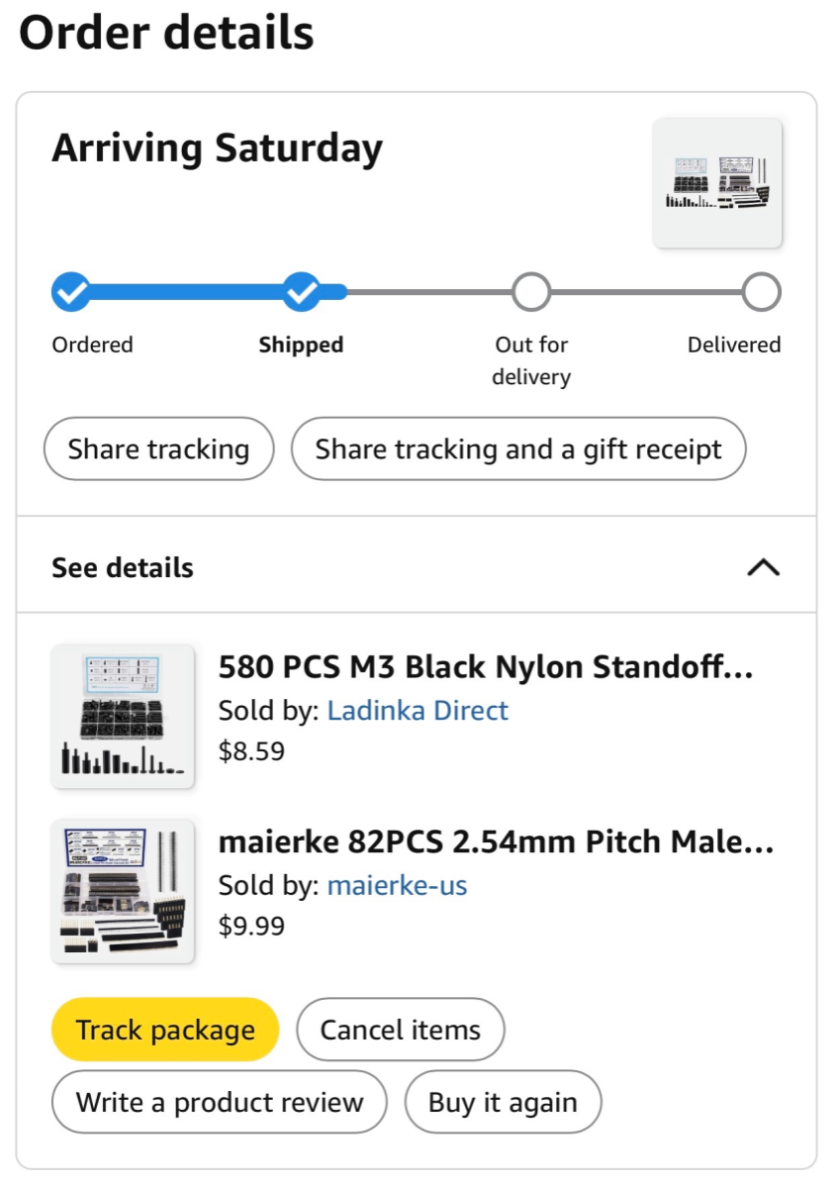
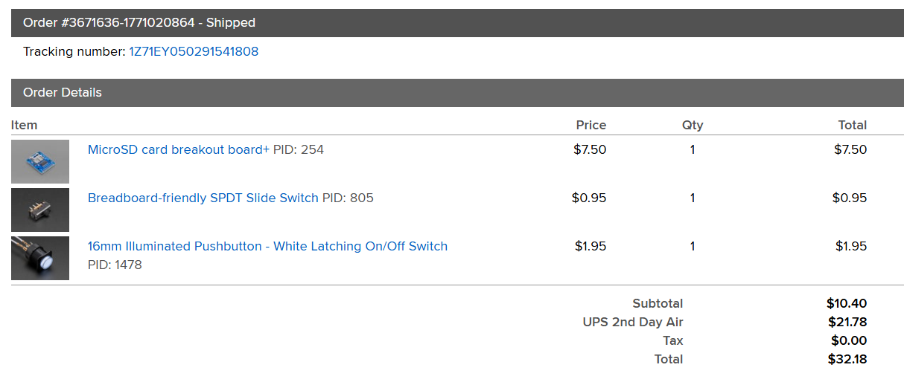
New Parts
MicroSD card expansion slot
Latching Button
M3 Screw and standoff set
Stackable Pin Headers

Slide 4
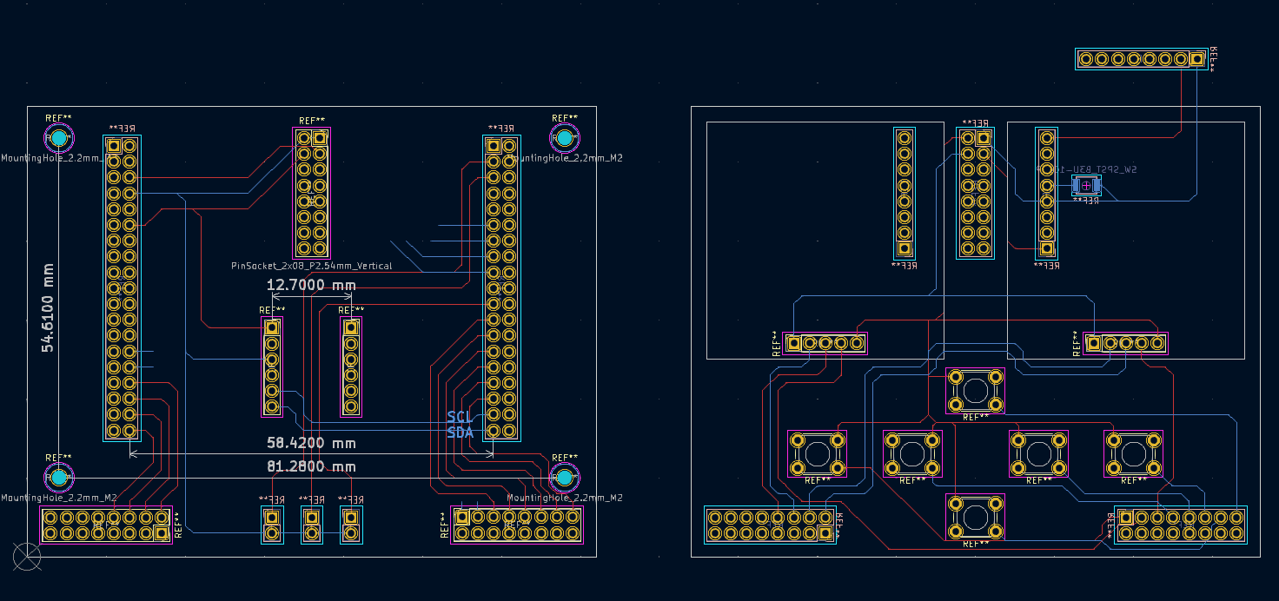
Small PCB design Update
Added new parts, but still unfinished. Want to clean up also.

Slide 5

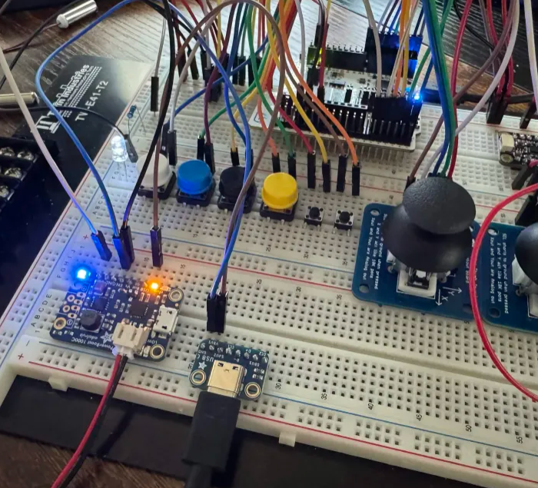
Charging Circuit and Power Working
Power supply being charged while program is running on board not connected to computer.
Final Design will have actuating switch for power on and off, for now just a jumper wire.

Slide 6
Stuck On BLE and HID interface.
Got Bluetooth working on a P2P example project offered by STM, but my selected board does not have any code generation for HID setup.
I will either need to make it from scratch using a custom template which may be time consuming and difficult
Can also convert an example project from the WB55RG board which has many more examples of HID and is nearly identical in architecture. Apparently, this isn’t that hard and is somewhat documented.

Slide 7
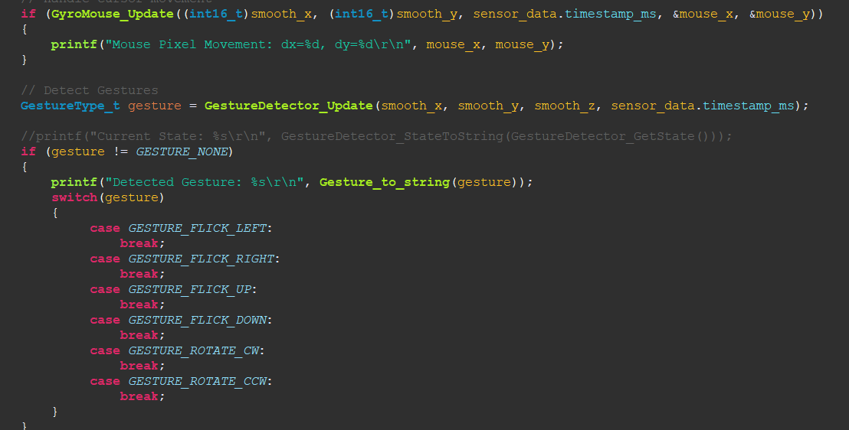
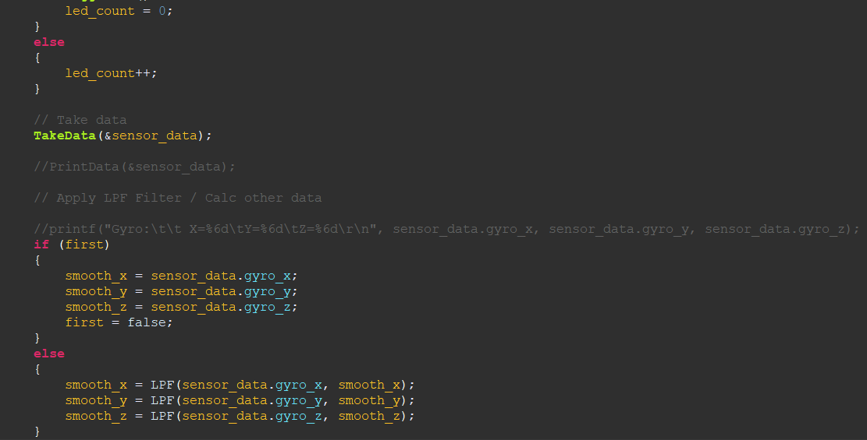
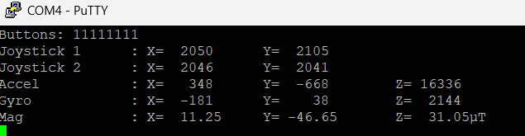
Main rewrite
Doubled Clock Speed and got ADC/DMA working at faster speeds.
Main rewritten to be more appropriate of usage.

Slide 8
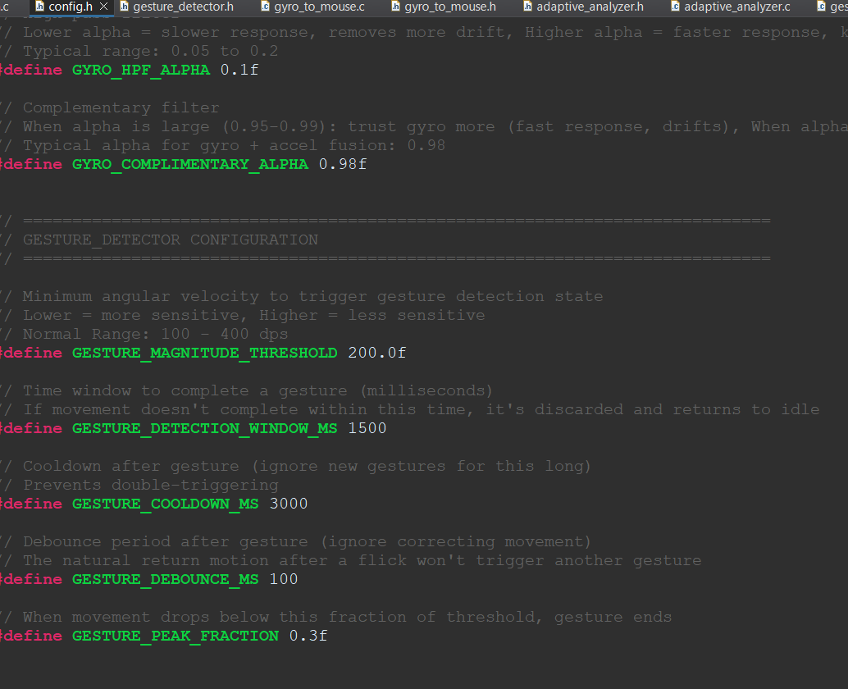
Config File
Start of config file
Just #defines for now, will need to turn into variable if I want to change them while code running

Slide 9
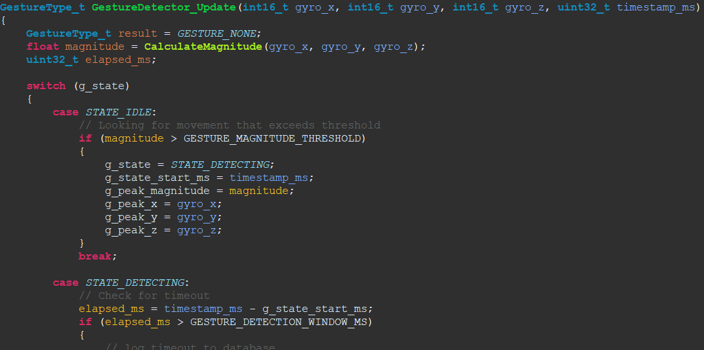
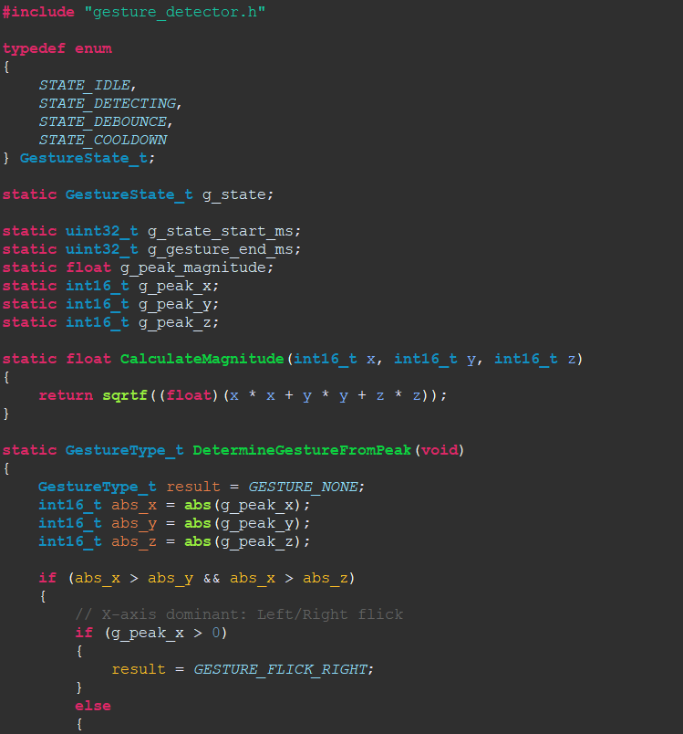
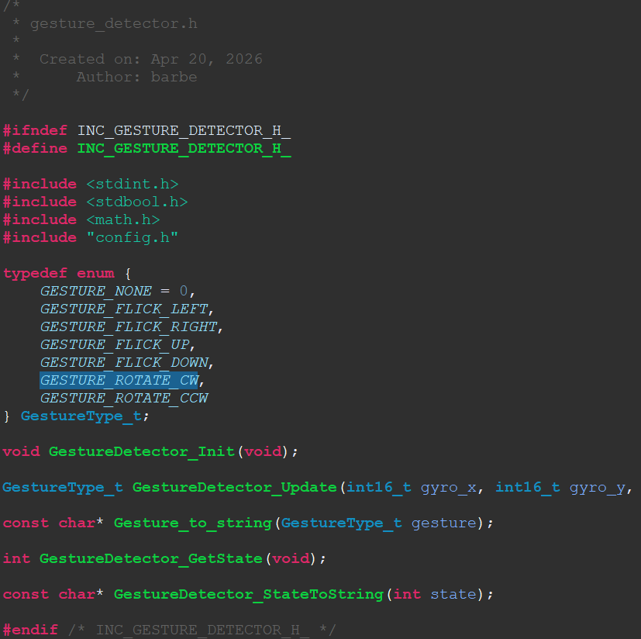
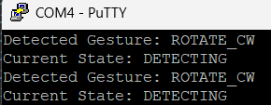
Gesture Detector code
Gesture detection code is largely complete, butslightly janky and difficult to test because of the state of wire mess.
Acts as a state machine which returns a gesture enum and logs the event when gesture is recognized.

Slide 10
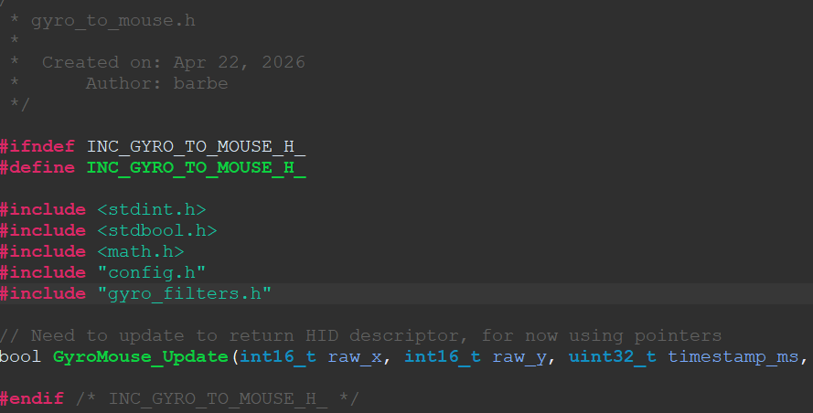
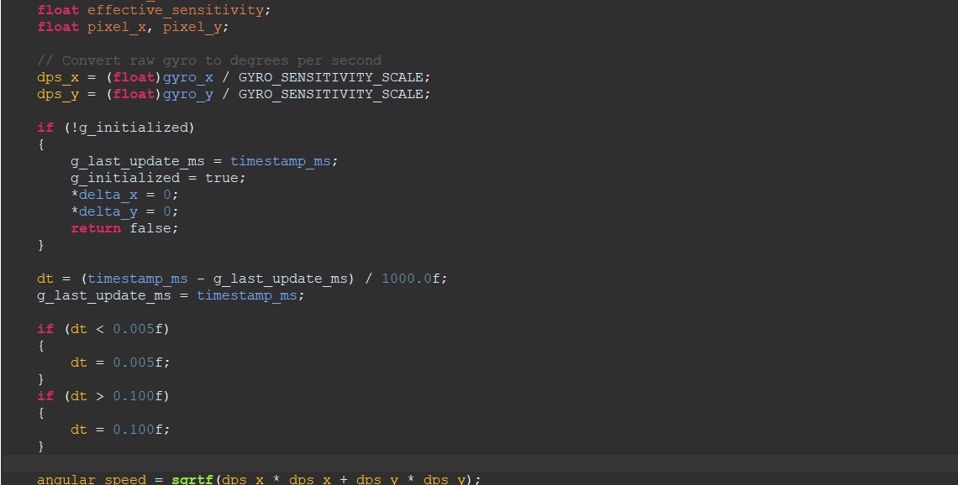
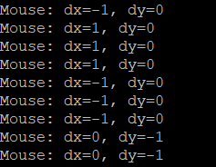
Gesture to Mouse Movement
Though cannot be implemented yet as I don’t have BLE or HID, Gesture to cursor movement should be mostly done.

Slide 11
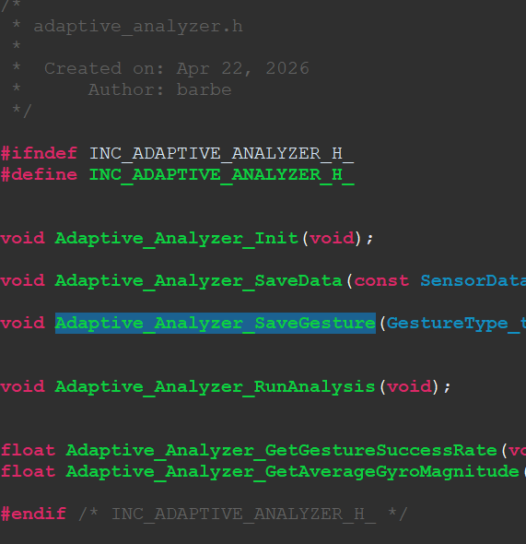
Adaptive Analyzer
Not implemented yet but is the next step in software design.

Slide 12
Next Steps
Get BLE and HID communication working
Finalize Multilevel PCB to print (by Sunday 4/26 at the latest)
Print Cad Models (Have finished prints by next Friday)
Assemble (Parts should come in at the same time allowing me to finally construct controller)
While waiting for parts continue working on software portion
After put together, fine tune gesture control settings to do more accurate testing

